Slide 1

ME 165
Mechanical Engineering Fundamentals
Lecture 4
Md. Aminul Islam
Lecturer
Department of Mechanical Engineering, BUET

Slide 2
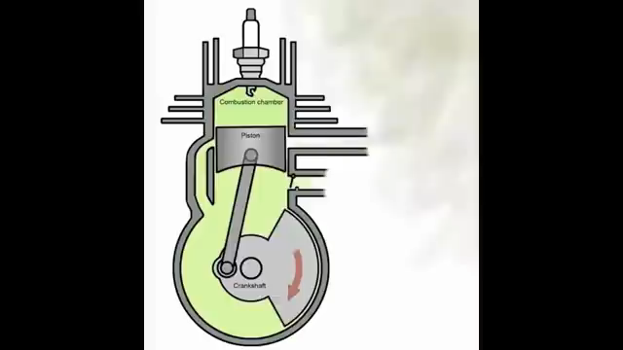
2-stroke SI (Petrol) engine operation
https://www.youtube.com/watch?v=xNLE8G3pC0k

Slide 3
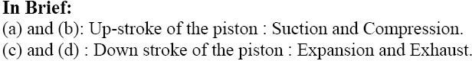
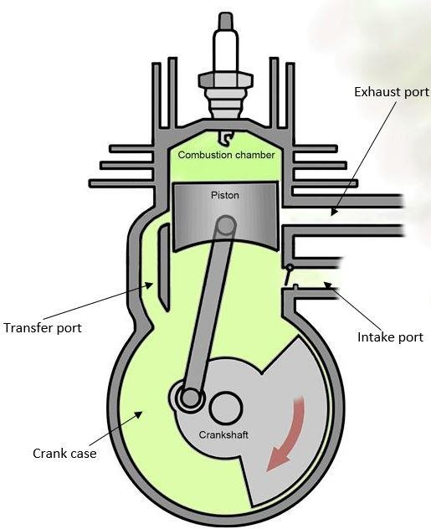
2-stroke SI (Petrol) engine operation

Slide 4
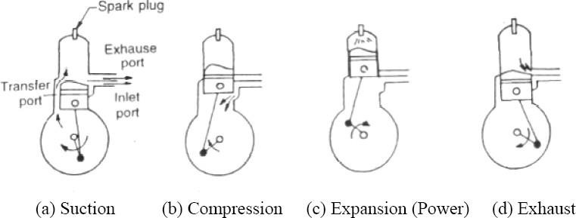
2-stroke SI (Petrol) engine operation

Slide 5
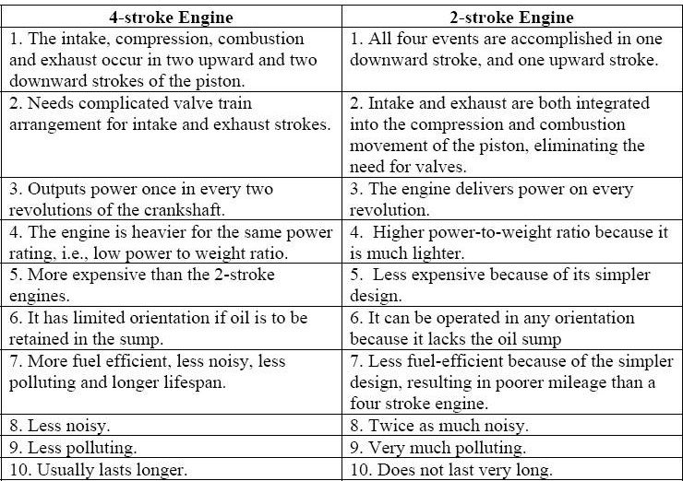
Comparison of 2-stroke and 4-stroke Engines

Slide 6

Problem 1
A six-cylinder two-stroke engine with a compression ratio r = 9 produces a torque of 1100 Nm at a speed of 2100 rpm. It has a bore b of 123 mm and a stroke s of 127 mm.
What is the displacement volume and the clearance volume of a cylinder?
mean piston speed
Solution:
V_{d} = (π/4) * b² * L
We know that r = (V_{d} + V_{c})/ V_{c}
U_{p} = 2NL/60

Slide 7
Problem 1
A six-cylinder two-stroke engine with a compression ratio r = 9 produces a torque of 1100 Nm at a speed of 2100 rpm. It has a bore b of 123 mm and a stroke s of 127 mm.
What is the displacement volume and the clearance volume of a cylinder?
mean piston speed
Solution:
V_{d} = (π/4) * b² * L
= 1.51 × 10⁻³m³
We know that r = (V_{d} + V_{c})/ V_{c}
The clearance volume, V_{c} = V_{d} /(r −1)
= 1.89 × 10⁻⁴ m³
U_{p} = 2NL/60 = 2 * (2100/60) * 0.127 =8.89 m/s

Slide 8
Problem 2
A three-liter SI V6 engine that operates on a four-stroke cycle at 3600 RPM. The compression ratio is 9.5, length of the connecting rods is 16.6 cm, the engine is square (B=L) Calculate:
Cylinder bore
Stroke length
Average piston speed
Clearance volume of one cylinder
Solution:a. Given, Swept volume, Vs=3×10⁻³m3 RPM of engine, N = 3600
The engine bore, B=? Stroke length, L =?
We know, V_{s}= n×(𝜋/4×B²×L )
(here n is no. of cylinder)/

Slide 9
Problem 2
Since B = L, so L = 0.086 m
Average piston speed Sp =?
We know, Sp = 2NL
= 2×3600×0.086 m
= 2×(3600/60)×0.086 m
= 10.32 m/s
Clearance volume of one cylinder: the clearance volume for one cylinder, We know that r = (V_{d} + V_{c})/ V_{c}
The clearance volume, V_{c} = V_{d} /(r −1)= 352.941 cm³
V_{C} = 352.941/6 cm³ = 58.82 cm³ ≈ 59 cm³

Slide 10
IC Engine Subsystems

Slide 11
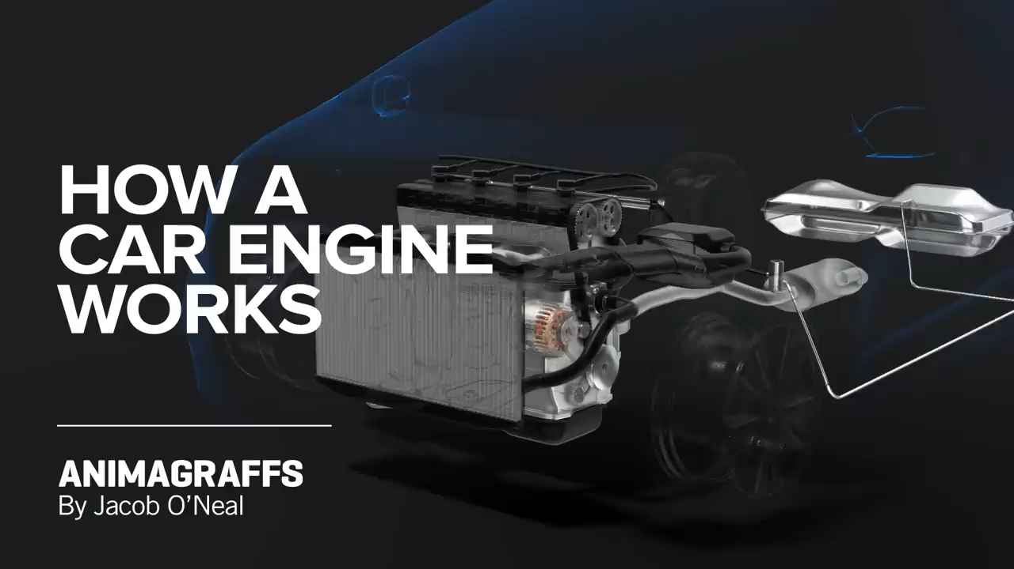
Engine Subsystems
https://www.youtube.com/watch?v=ZQvfHyfgBtA

Slide 12

Engine Subsystems
https://www.youtube.com/watch?v=vIJ50aUiBgM&t=9s

Slide 13
Engine Subsystems
Valve Operation
Air Intake & Exhaust System
Fuel Supply System
Ignition System
Lubrication System
Cooling system
Starting System

Slide 14
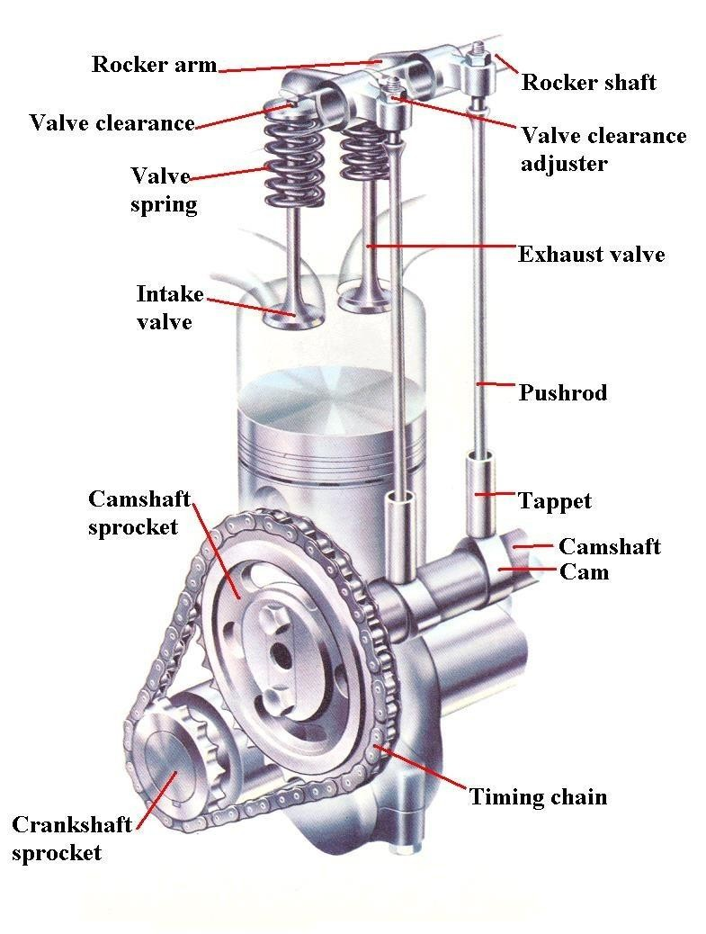
IC Engine: Valve Operation
Cam: Mechanical component used to convert rotary motion into reciprocating motion
Cams are fitted in a camshaft
Camshaft is driven by crankshaft by chain-sprockets
or timing gears
1 cam required for each valve
Camshafts rotate at half the speed of the
crankshaft
Total engine rotation: 720°
IVO : 0°to 180°
EVO: 540°to 720°

Slide 15

Indicator and valve-timing diagram for a 4- stroke SI engine
https://www.youtube.com/watch?v=Te-OltNQRUk
https://www.youtube.com/watch?v=fTAUq6G9apg&t=39s

Slide 16
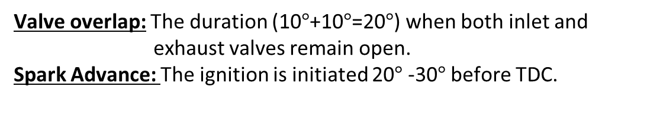
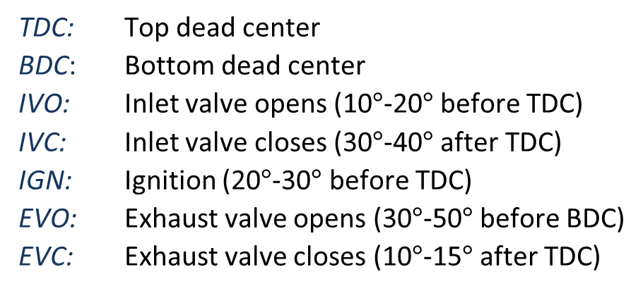
Indicator and valve-timing diagram for a 4- stroke engine
Terminology:
TDC: Top dead center
BDC: Bottom dead center
IVO: Inlet valve opens (10$°$-20$°$ before TDC)
IVC: Inlet valve closes (30$°$-40$°$ after TDC)
IGN: Ignition (20$°$-30$°$ before TDC)
EVO: Exhaust valve opens (30$°$-50$°$ before BDC)
EVC: Exhaust valve closes (10$°$-15$°$ after TDC)
Valve overlap: The duration (10$°$+10$°$=20$°$) when both inlet and exhaust valves remain open.
Spark Advance: The ignition is initiated 20$°$ -30$°$ before TDC.

Slide 17
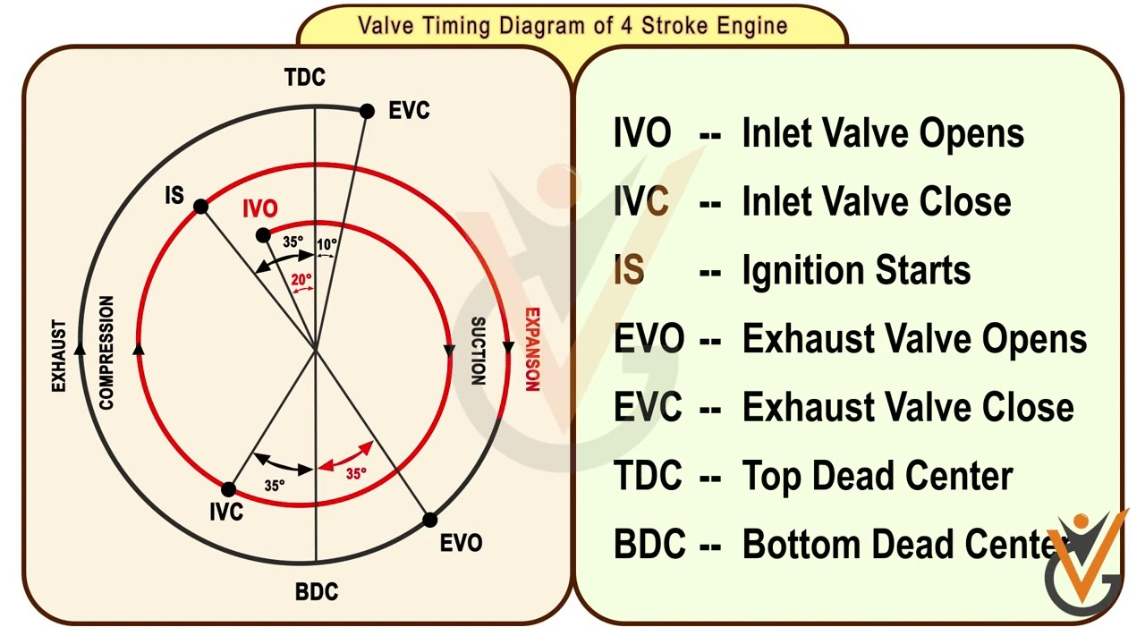
Indicator and valve-timing diagram for a 4- stroke engine
Figure: Valve timing for a four-stroke cycle engine.

Slide 18
Indicator and valve-timing diagram for a 4- stroke engine
Valve timing diagram: The exact moment at which the inlet and outlet valve opens and closes with reference to the position of the piston and crank shown diagrammatically is known as valve timing diagram. It is expressed in terms of degree crank angle.
Opening and closing of inlet valve
- Inlet valve opens 12 to 30ᵒ CA before TDC to facilitate full opening of the inlet valve by the time piston reaches TDC.
-Inlet valve closes 10-60ᵒ CA after TDC due to advantage of the velocity of the Incoming gases, helping to continue filling the cylinder with additional air-fuel mixture even though the piston is moving back up the cylinder. This effect can be called ram effect. IVC one of the main factors in determining volumetric efficiency.

Slide 19
Indicator and valve-timing diagram for a 4- stroke engine
Opening and closing of exhaust valve
Exhaust valve opens 25 to 55ᵒ CA before BDC to reduce the work required to expel out the burnt gases from the cylinder. This is called blowdown.
Most of the power of the burning gases is delivered to the piston by about halfway through the power stroke so opening the exhaust valve at this point does not significantly reduce an engine’s power output.
Exhaust valve closes 10 to 30ᵒ CA after TDC to avoid the compression of burnt gases in next cycle. Kinetic energy of the burnt gas can assist maximum expelling of the gas. It also increases the volumetric efficiency.

Slide 20
Acknowledgement
Slide Courtesy:
Dr. Aman Uddin, Assistant Professor, Department of Mechanical Engineering, BUET
Saif Al-Afsan Shamim, Assistant Professor, Department of Mechanical Engineering, BUET

